Slide 1



Prospective consumers: An actionable identification framework
>200
>50
4
Top academic papers reviewed
Academic papers cited
Academic fields covered
Psycho-Demographics
Context
Trigger
Demographics
Motivations
Barriers
Personality
Life events
Moments
Marketing
Age
Gender
Family status
Occupation
Vanity
Lifestyle
Social
Convenience
Technology
Brand trust
Taste
Rituals
Self-perception
IQOS pricing
IQOS perceived negative attributes
Credibility
CC social conformity
CC brand authentication
Variety seeking
Openness to change
Risk aversion
Self monitoring
Engagement
Marriage
New home purchase
Relocation
Parenthood
Divorce
Children moving out
Retirement
New Year’s
A night out
Social gathering e.g. brunch
Attending a live event
Seasonal event e.g. summer holiday
Weather
Paid e.g. ads
Owned e.g. website
Shared e.g. word of mouth
Earned e.g. influencer/blogger relations
In-store fundamentals
IQOS Awareness, Engagement, Conversion
This material is strictly confidential and should not be shared nor distributed internally or externally except to those PMI employees and/or consultants who need the material in order to perform their tasks on behalf of the Company. Care must also be taken in handling the material to prevent unauthorized access. Any unauthorized distribution or careless handling will be subject to disciplinary action. All references to smokers, LAS, LAU, users, consumers, followers, audience mean ‘smokers of legal age to smoke’ and/or ‘legal age users of IQOS’.
Notes:
High credibility: Based on extensive external and internal papers and studies
Comprehensive: Not only the demographics, but everything around a person AND context AND triggers.
We are focusing now on motivations, because these can be extrapolated from behavior, from surveys, and they can immediately be turned into content.
From this we made a huge dictionary of 5000 words that all are related to this framework.
We tested this framework on Twitter by tagging text in all these different categories. We decided to do Twitter because it has the rich user generated content and if it works on social, we can apply it to other outputs easily such as display.

Slide 2
Motivations
Psycho- Demographics
Pillar | IQOS Benefits | Description
Vanity | IQOS improves an individual’s self-presentation on many fronts. Sleek Environmentally Conscious More respectful of shared air space | Concerned with self-presentation and personal environment. As vanity involves comparison with others, it can serve as a motivation for change (e.g. physical appearance, in fashion, in achievement)
Lifestyle | IQOS is a lifestyle product, likely to be less harmful than CC | Defined as consumer patterns-how they live and where they spend their time and money. For PMI, there is a unique marketable area in aligning with the well-being and nutrition lifestyle
Social | Scientifically proven to produce less smoke and bad odor, IQOS significantly reduces the negative impact of smoke for those near IQOS users. On the other hand, IQOS consumption can also serve a social function when consumed in a group. | Concerned with social standing, networking, interacting positively with others, and building/maintaining relationships with others
Convenience | IQOS can be used in places and situation where smoking is forbidden or undesirable | Place importance on convenience in life
Technology | IQOS, which is part of a new technology movement, is an exciting new product for technology lovers to try. | Comfort with technology and pleasure in gadgetry, and a general interest in emerging and advanced technology
Brand trust | IQOS is produced by a trusted company / part of a trusted brand. | The belief that a brand will yield positive outcomes (e.g. physical pleasure, positive experience interacting with the product) when consumed
Motivations
Vanity
Lifestyle
Social
Convenience
Technology
Brand trust

Slide 3
Questions on motivations
Idea: 6-10 questions
Consumer picks 1 picture out of 4 pictures.
Questions for example:
Where do you like to smoke?
How do you like to spend time on the weekends?
Answers will be 4 pictures representing the motivations. This will be done in different combinations so that consumers have to decide between the different motivations.

Slide 4
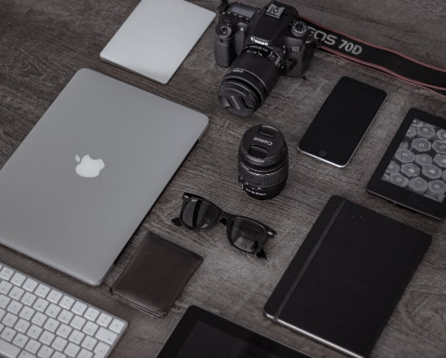
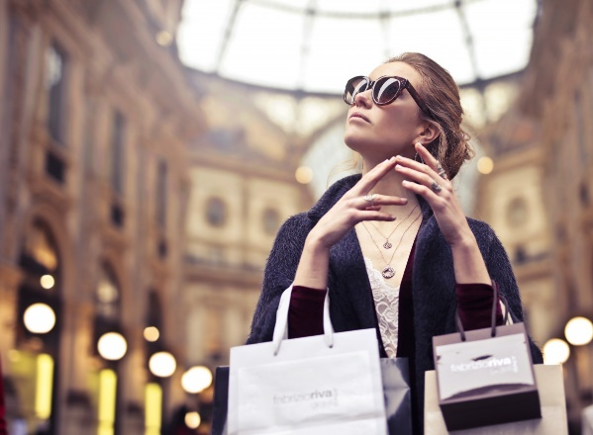
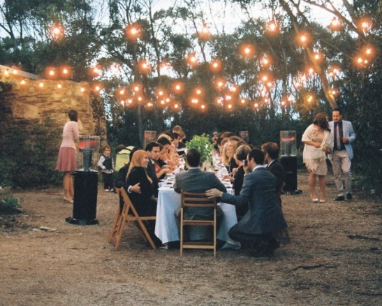

GAMIFICATION
Collect attitudinal data from our consumers for more personalized communication
Better segmentation of consumers based on their attitudes
Create higher engagement with our consumers
How do you like to spend your weekends?
Entertaining with the latest technology
Shopping the most luxurious items
Interacting with friends
Work out

Slide 5
EXAMPLE QUESTIONS
How do you like to spend your weekends?
Where do you prefer to smoke?
How did you learn about IQOS?
What do you find an important characteristic in a partner? (only online, not a question for face-to-face)
What kind of grocery shopper are you?
People would describe me as being…
Tech: Entertaining with the latest technology
Luxury: Shopping the most luxurious items
Social: Interacting with friends
Lifestyle: Work out
Vanity: At home by myself
Convenience: During my work break
Social: At a party or social event
Lifestyle: All day – I can’t stop
Social: Via my friends
Lifestyle: Via my doctor
Tech: At a tech store?
Convenience: At the local tobacco shop
Social: That he/she gets along with my friends
Lifestyle: That he/she lives healthy
Luxury: That he/she is wealthy
Vanity: That he/she is good looking
NOT luxury: A bargain shopper
Lifestyle: I buy nutritious foods
Convenience: I am a quick in-out shopper
Vanity: Only in clean stores ☺
Social: A social animal
Lifestyle: An exercise enthusiast
Convenience: Balancing 10 things at the same time
Vanity: A neat freak

